Slide 1
Web scraping, cloud storage and analysis

Slide 2
Assignment 1 Deliverables
Part 1
Data collection
Perform Web Scraping techniques on 100 entries
Create a data frame suitable for scraped data
Platform of choice – Beautiful Soup
Part 2
Data Storage
Create database for using the data frame
Platform of choice - MongoDB
Part 3
Web Application Development
Connecting the database to a UI
Performing Create, Read, Update & Delete functions
Platform of choice - Flask

Slide 3
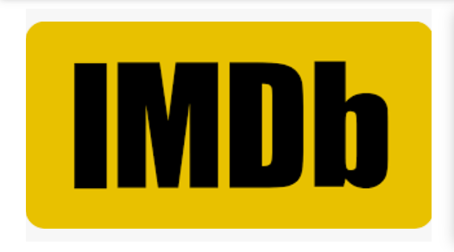
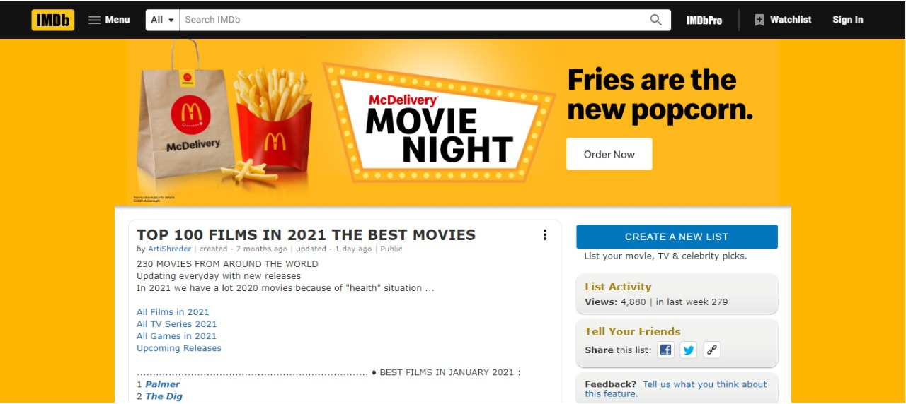
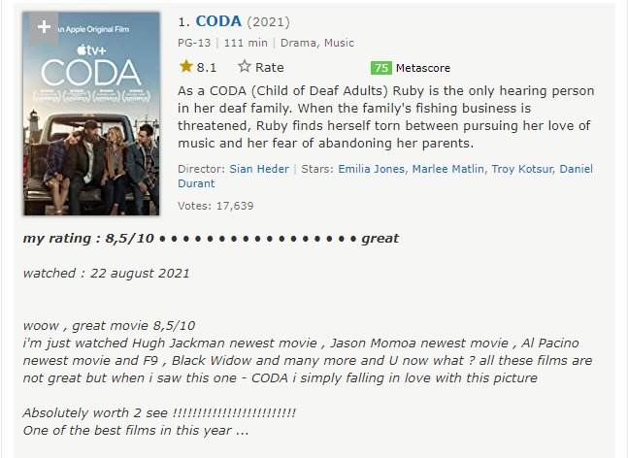
Data Source
Source Data – Best 100 movies of 2021 by IMDb

Slide 4
Technologies & Libraries Used
Technologies
Python
Flask
Bootstrap
MongoDB Atlas
Libraries
Beautiful Soup
PyMongo
Flask
pandas

Slide 5
1. Data Collection
Web Scraping
Data Frame

Slide 6
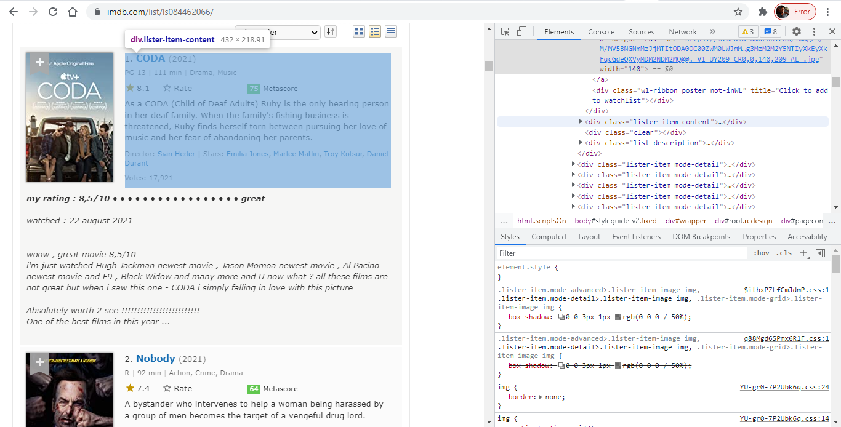
HTML Inspection and tags finding
Film Title
IMDB Rating
Run Time
Data labels
Genre
Short Narration
Director

Slide 7
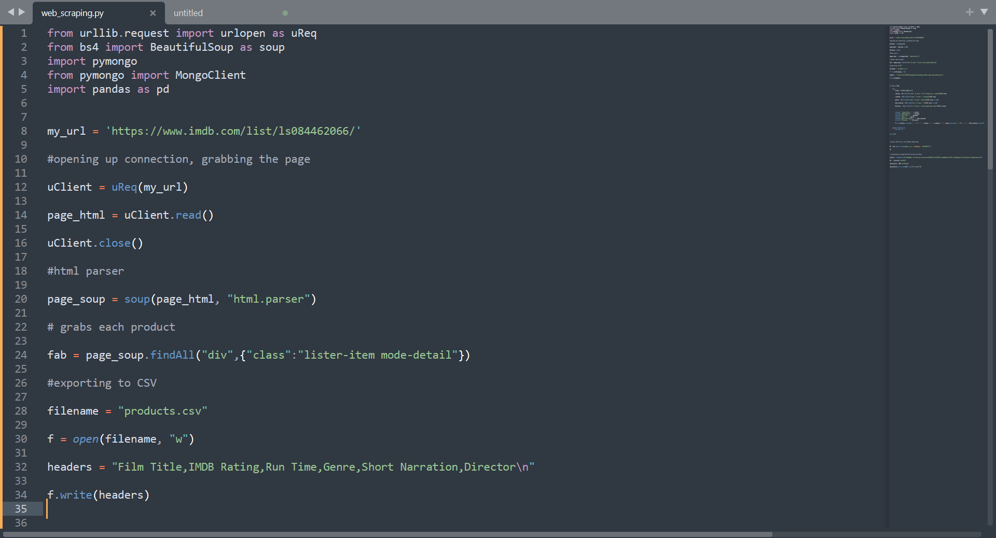
Web Scraping
Platform used – Beautiful Soup
Source code used for web scraping

Slide 8
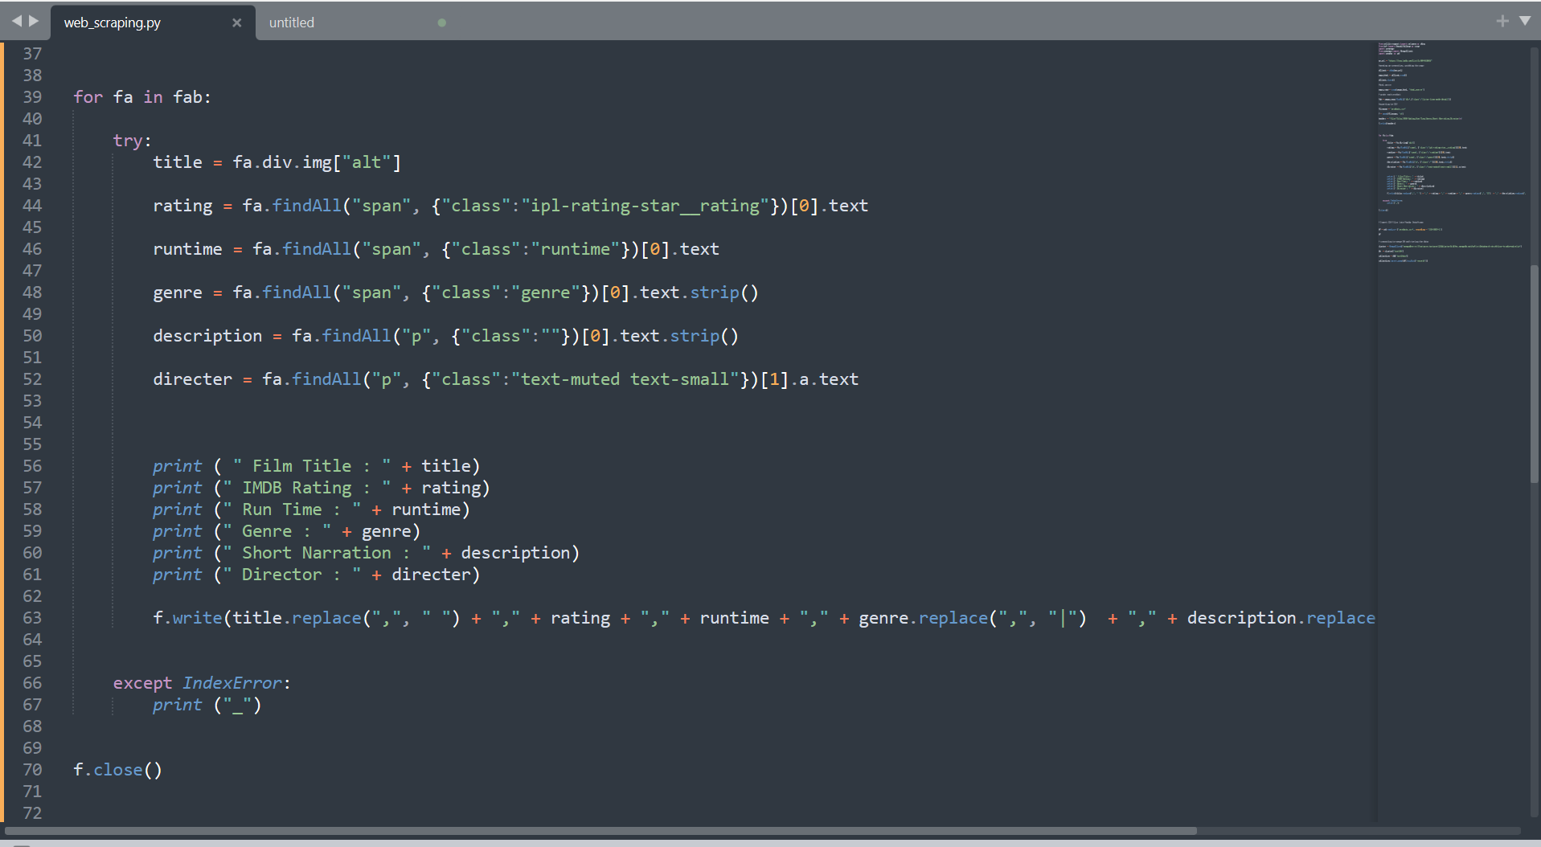
Source code used for web scraping

Slide 9
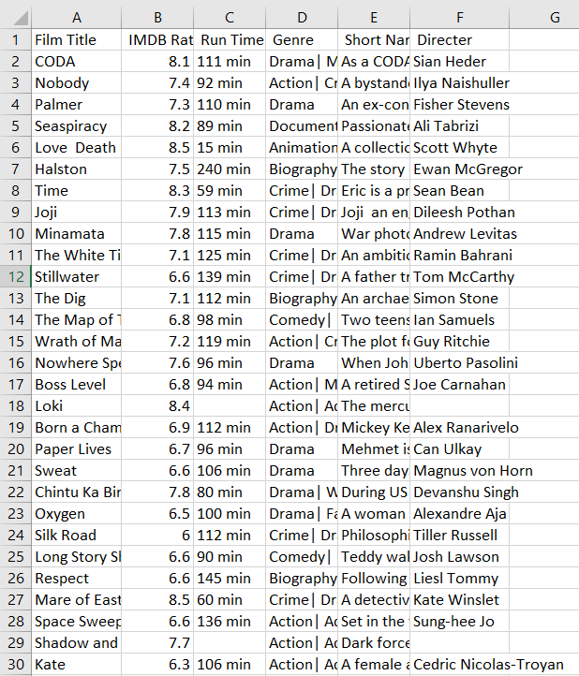
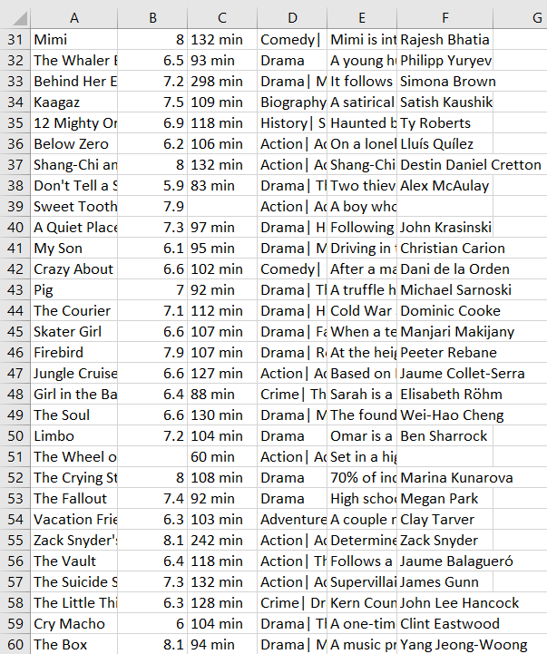
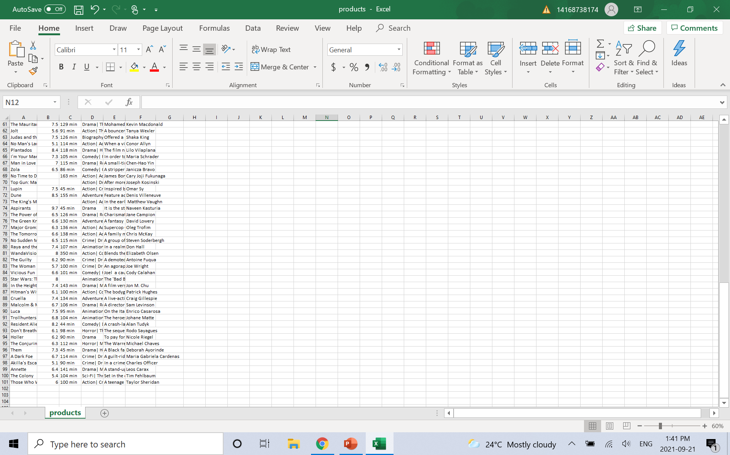
Web Scraping
.csv file created after scraping data

Slide 10
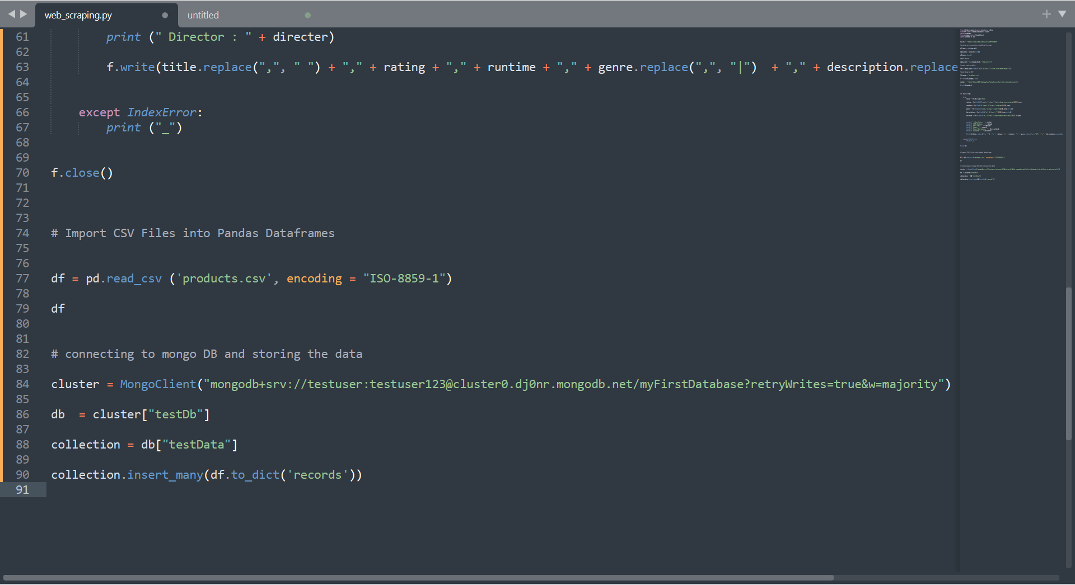
Data Frame
Importing .csv to data frame & sorting the data to MongoDB

Slide 11
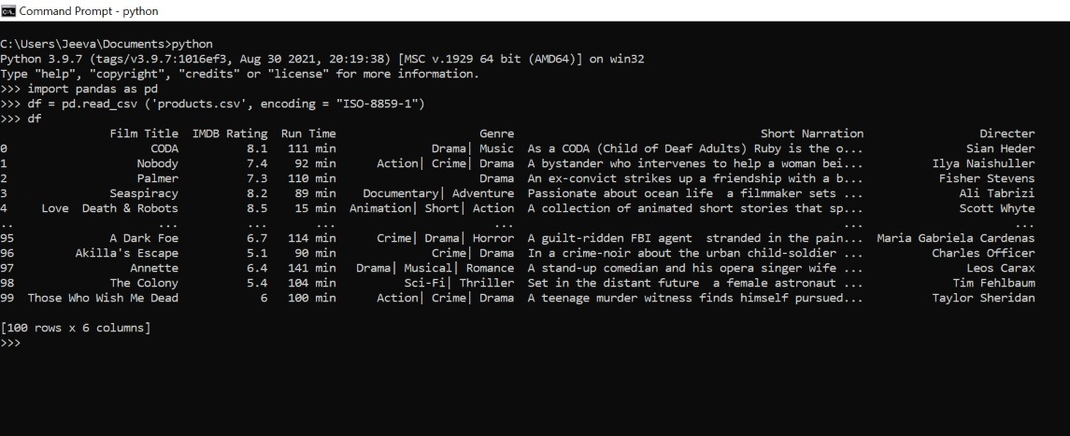
Web Scarping
Data frame created using the .csv file

Slide 12
2. Data Storage
Database Creation

Slide 13
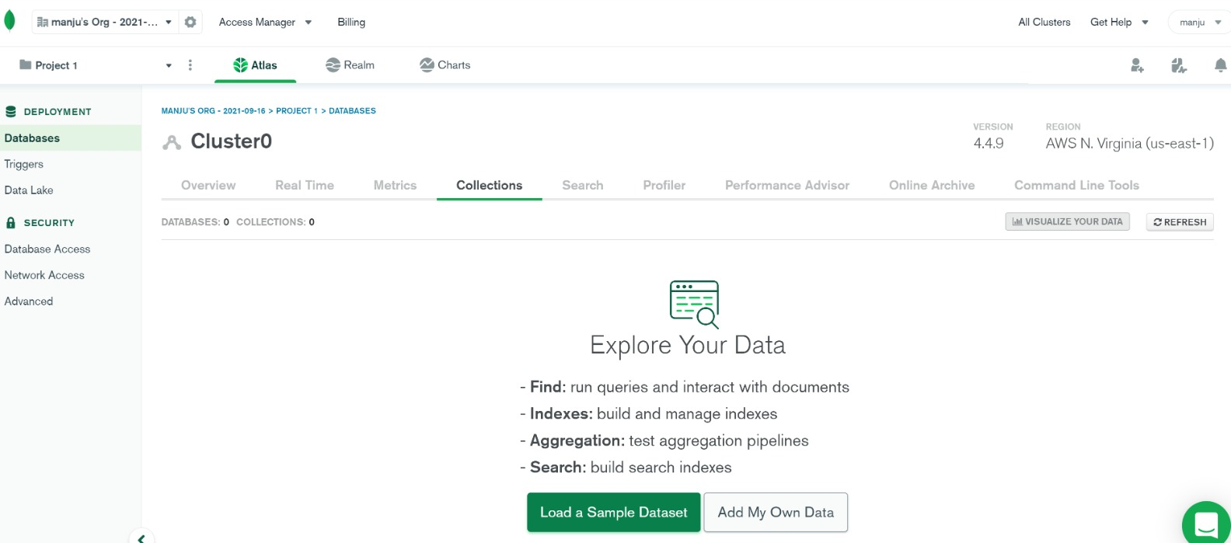
Database Creation
Platform used - MongoDB
MongoDB Atlas – before web scraping

Slide 14
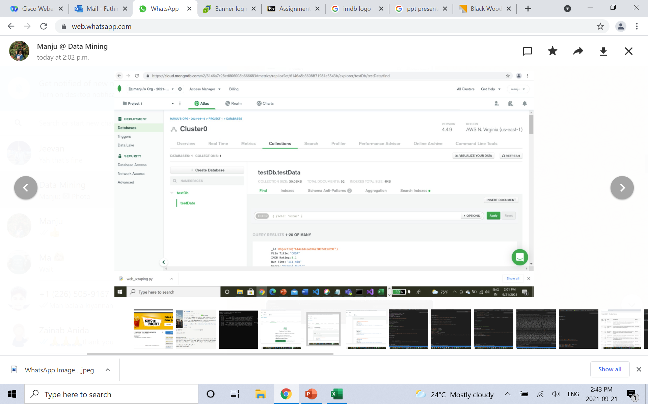
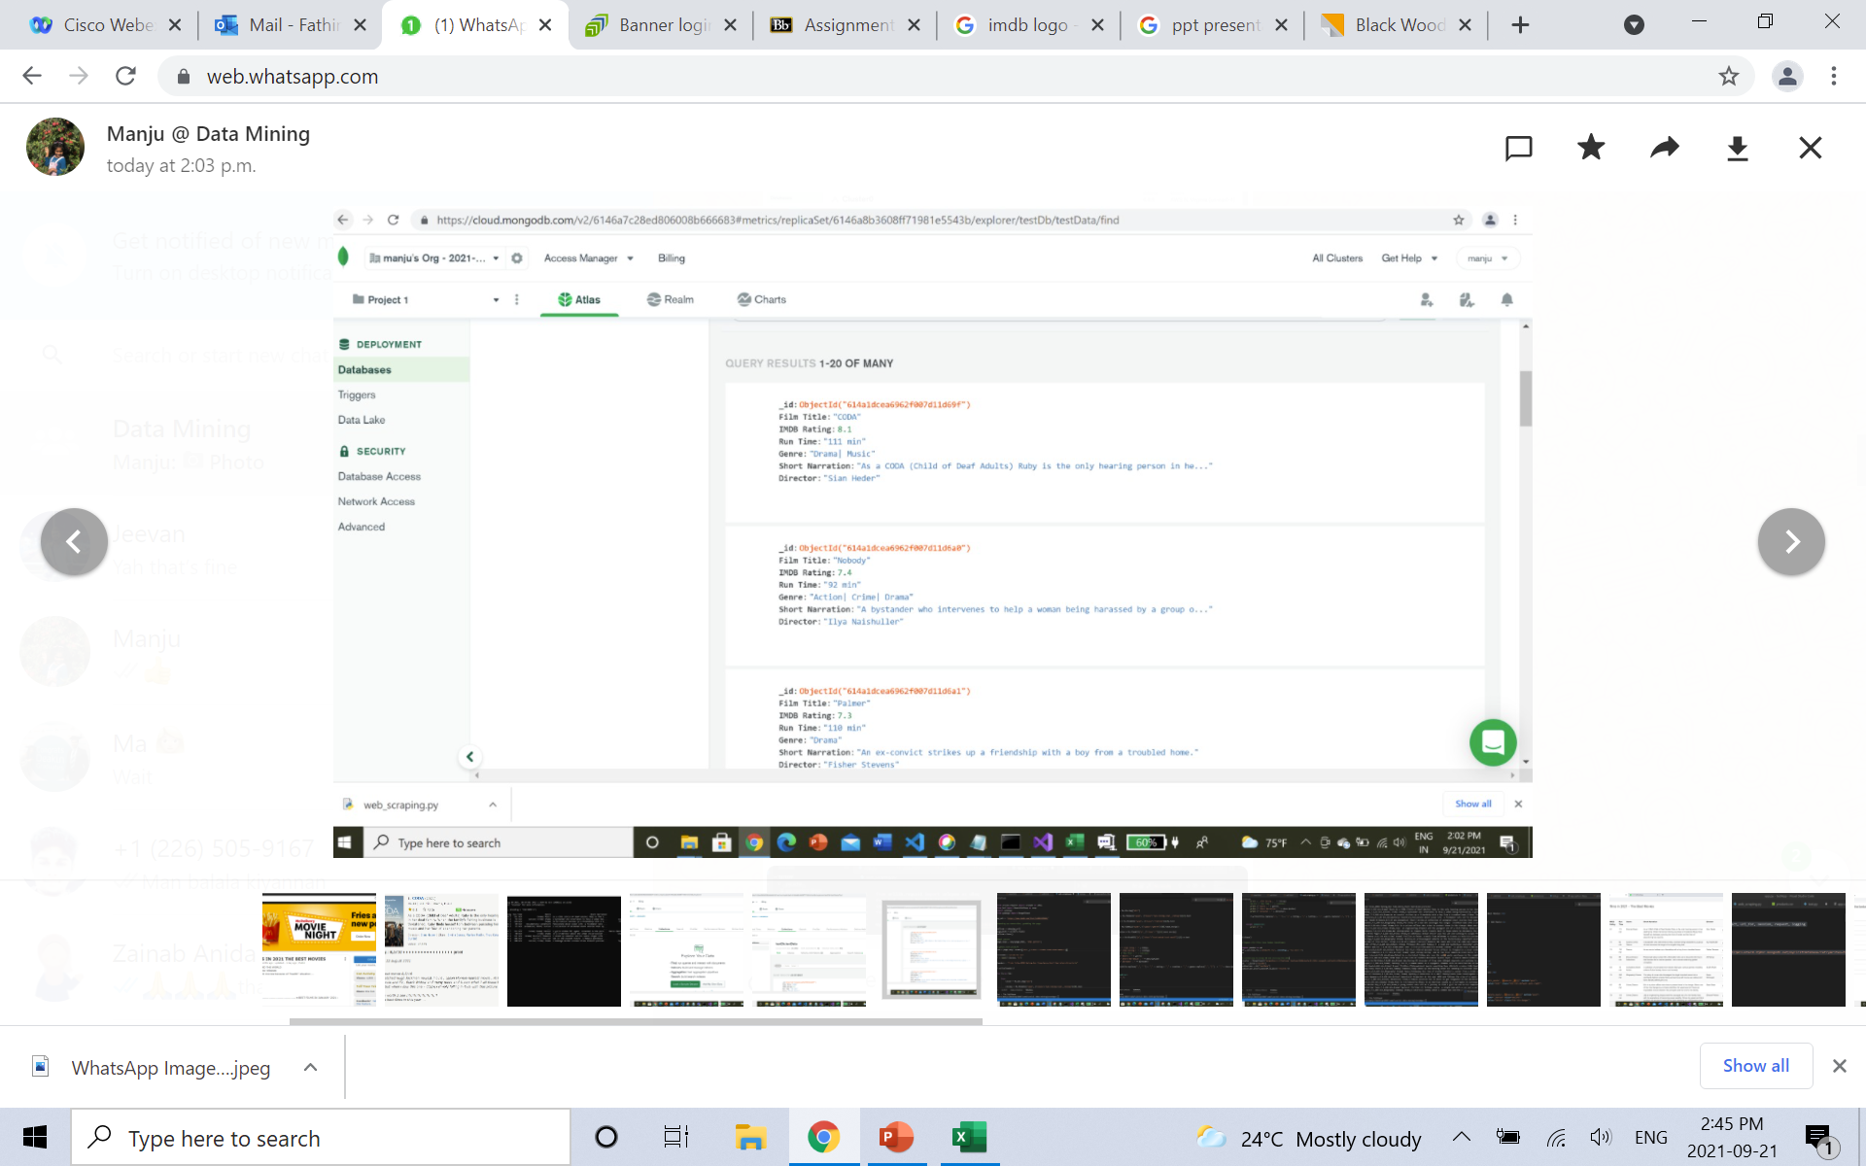
Database Creation
MongoDB Atlas – after loading web scraped data

Slide 15
3. Web Application Development
User Interface

Slide 16
Web App Development
User Interface
View – view all available information available on the database
Add – add new records into the database
Edit – make changes to existing records on the database
Delete – remove existing records from the database

Slide 17
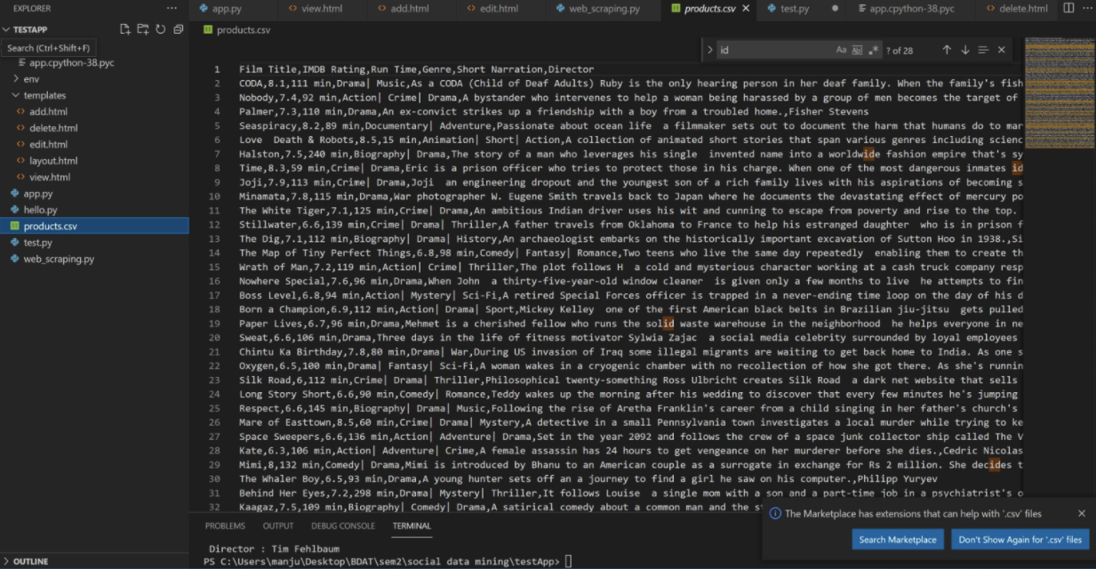
Web App Development
Platform used - Flask
Downloading .csv file into IDE

Slide 18
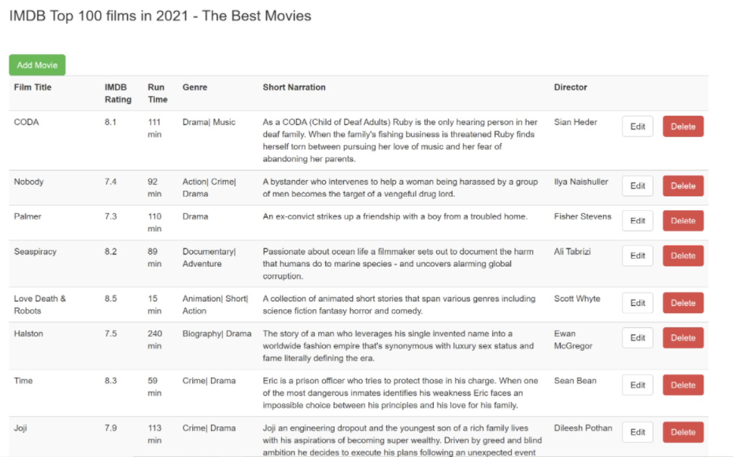
Web App Development
UI - View
View Page

Slide 19
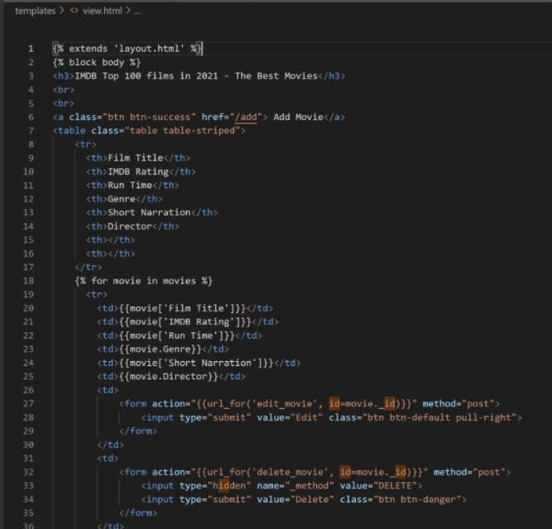
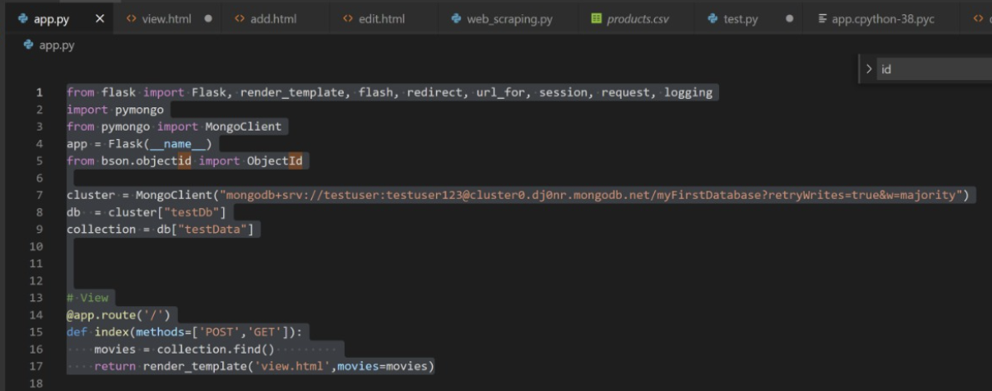
Web App Development
view.html Code
View Flask Code

Slide 20
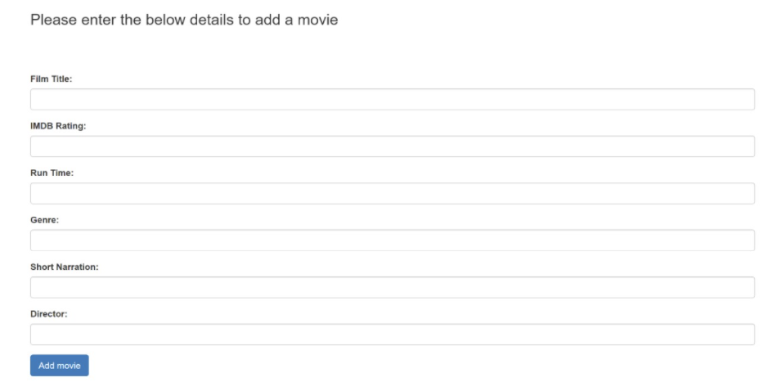
Web App Development
UI - Add
Add Page

Slide 21
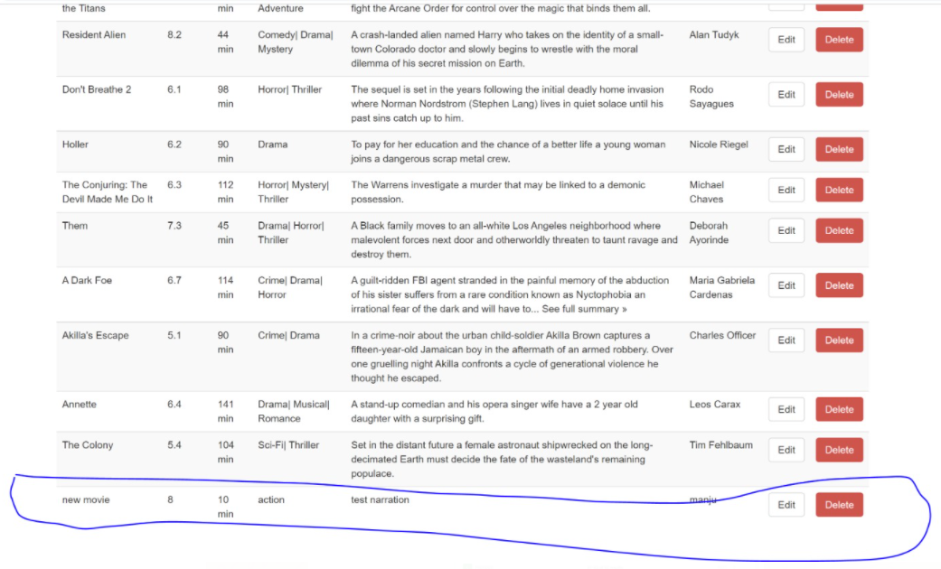
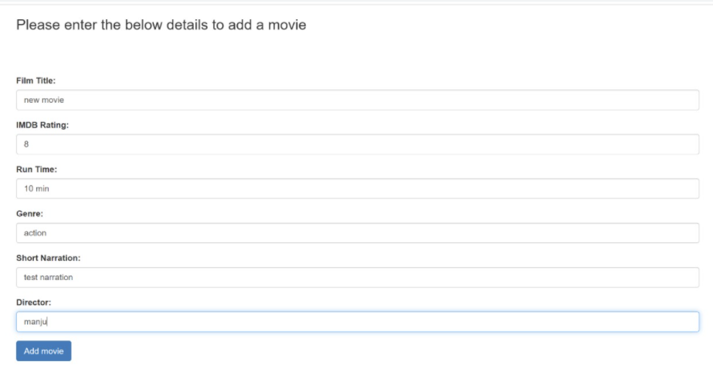
Web App Development
Entering data to Add Page
New Movie Updated on Add Page

Slide 22
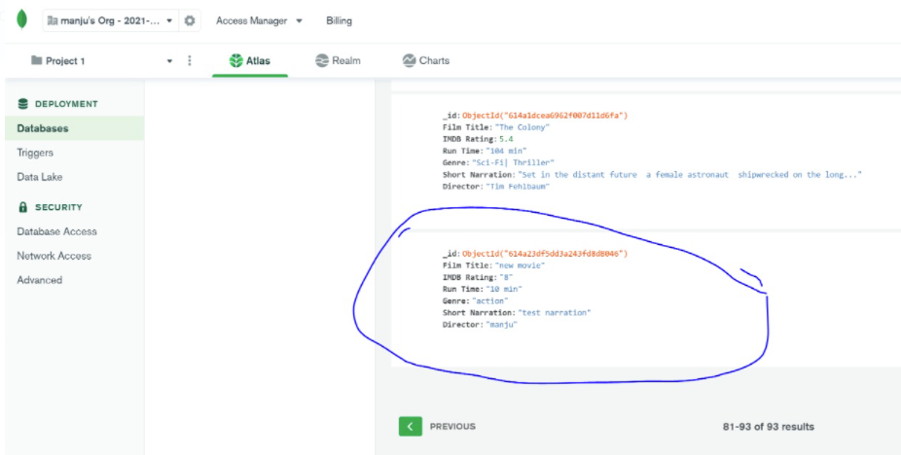
Web App Development
New Movie Updated on MongoDB

Slide 23
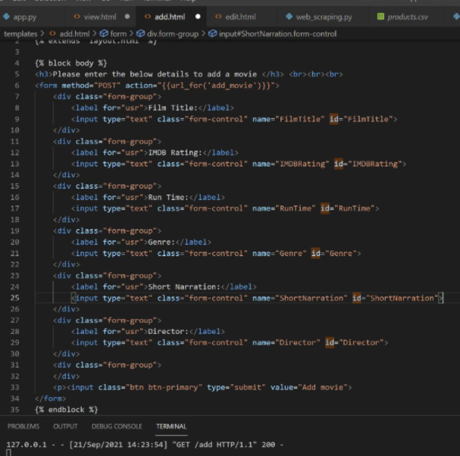
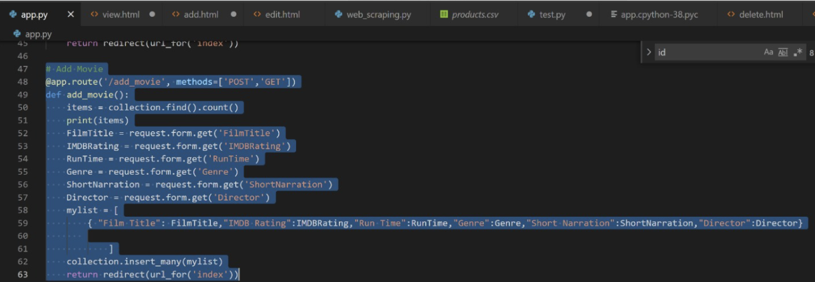
Web App Development
add.html Code
Add Flask Code

Slide 24
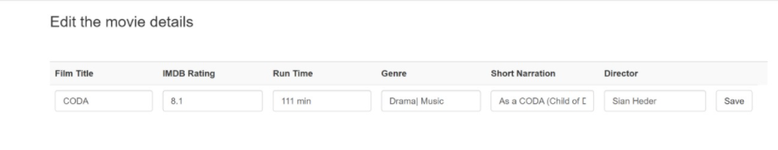
Web App Development
UI - Edit
Edit Page

Slide 25
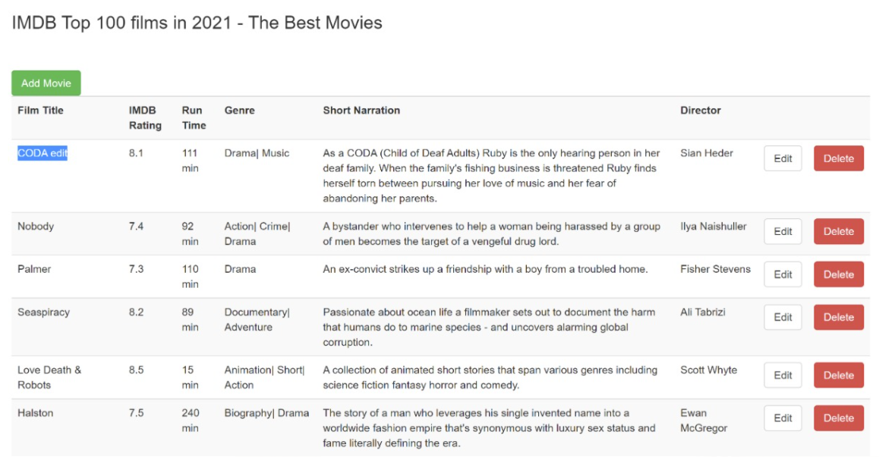
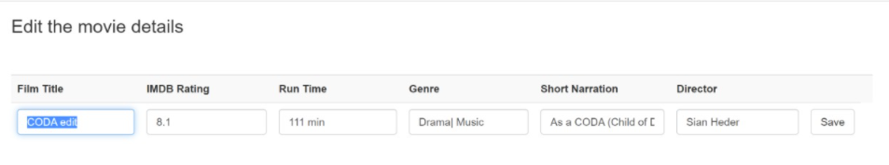
Web App Development
Edit Movie Name to CODA edit
CODA edit Updated on Edit Page

Slide 26
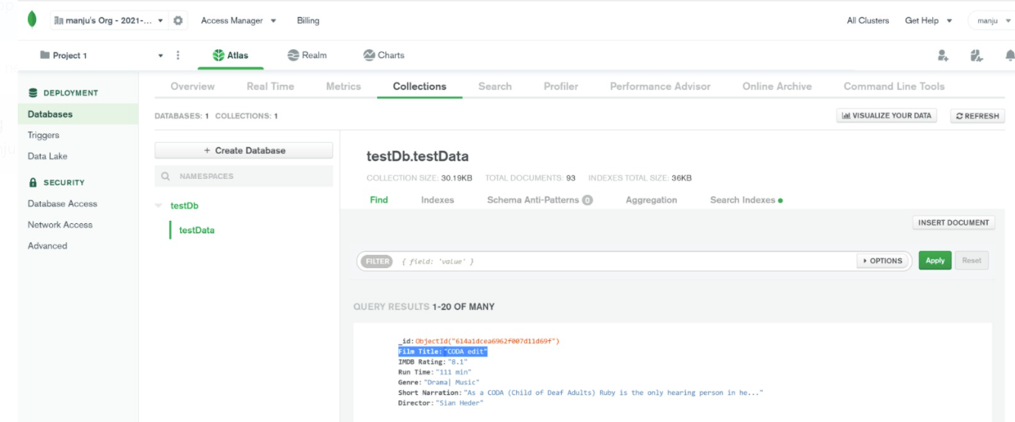
Web App Development
CODA edit Updated on MongoDB

Slide 27
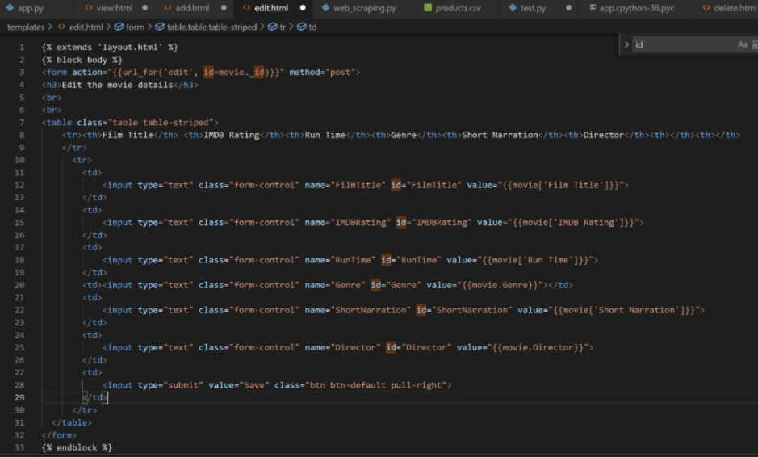
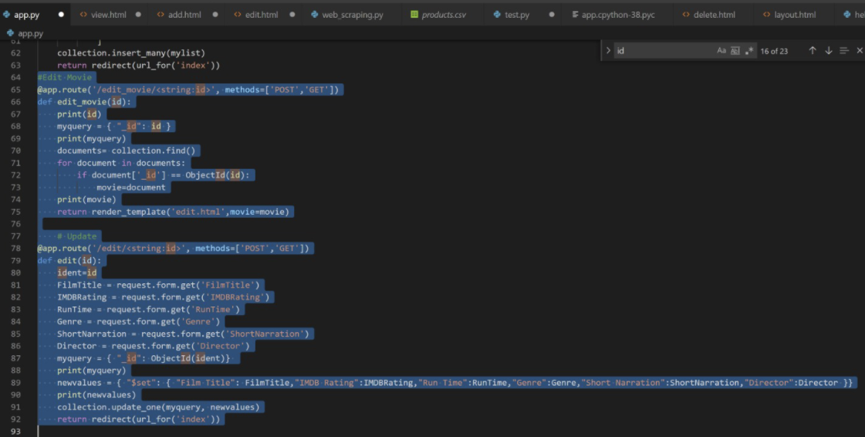
Web App Development
edit.html Code
Edit Flask Code

Slide 28
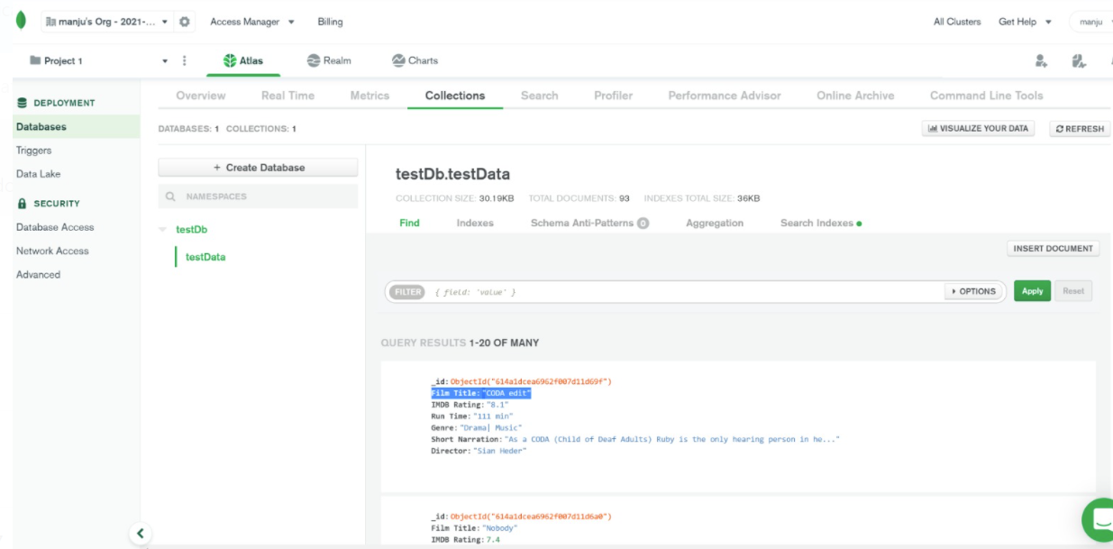
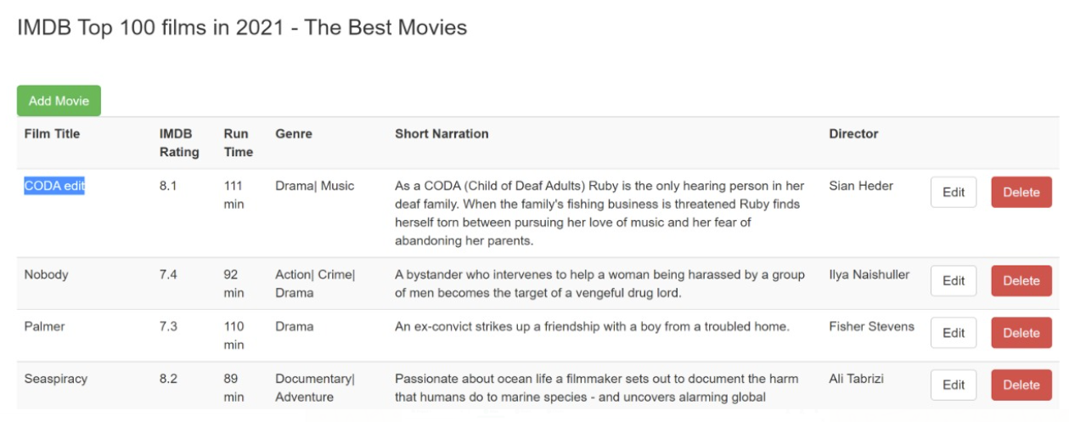
Web App Development
Function - Delete
Page Before Deleting
DB Before Deleting

Slide 29
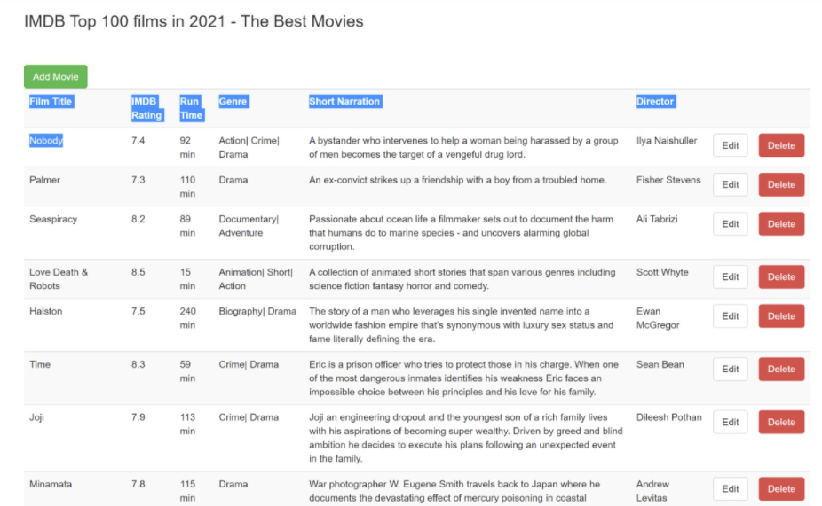
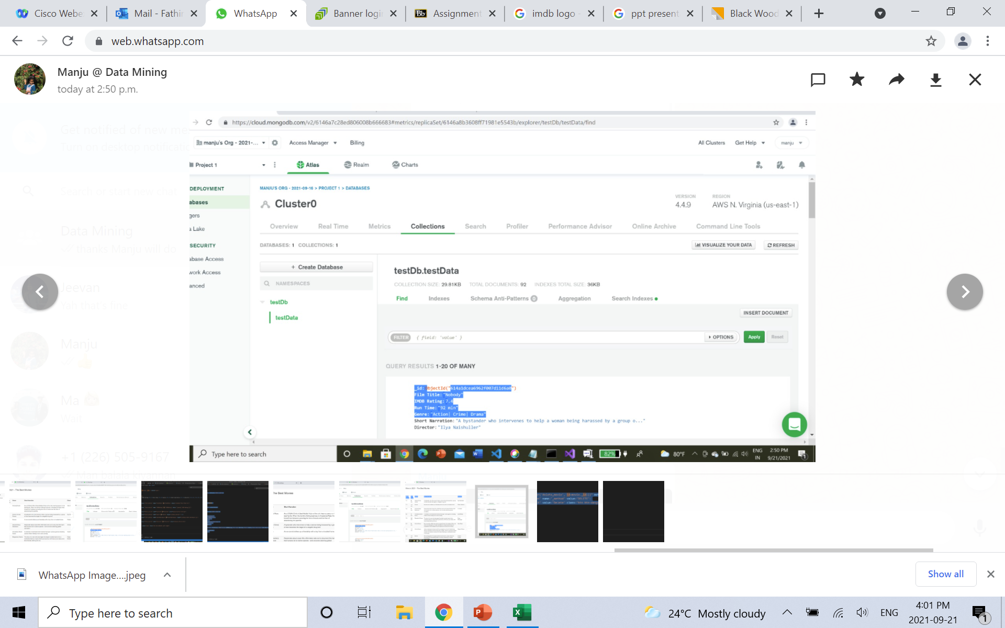
Web App Development
Page After Deleting
DB After Deleting

Slide 30
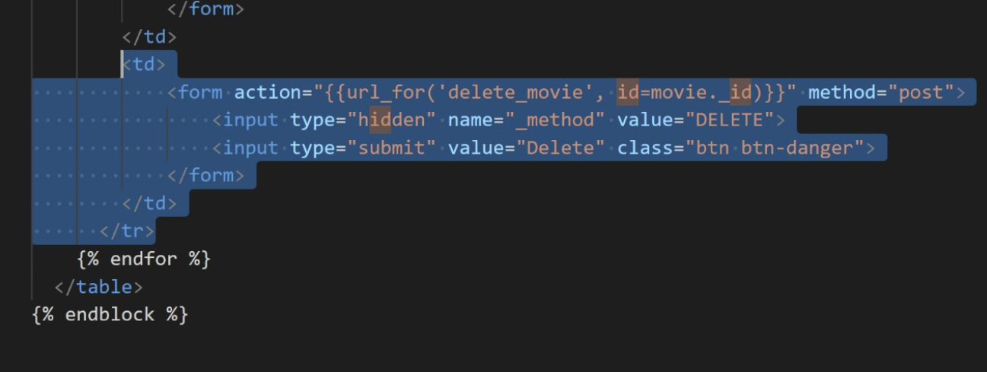
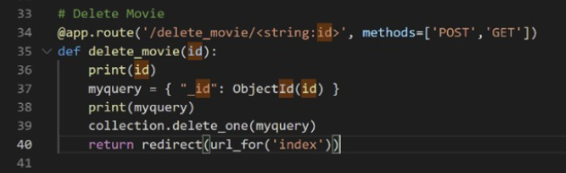
Web App Development
delete.html Code
Delete Flask Code

Slide 31
References
https://www.google.com/search?q=imdb+logo&rlz=1C1CHBF_enCA972CA972&source=lnms&tbm=isch&sa=X&ved=2ahUKEwieksyU0JDzAhW7GVkFHS_fDVIQ_AUoAXoECAEQAw&biw=1280&bih=632&dpr=1.5
https://www.slidescarnival.com/prospero-free-presentation-template/91

Slide 32
Thank You!

